Slide 1
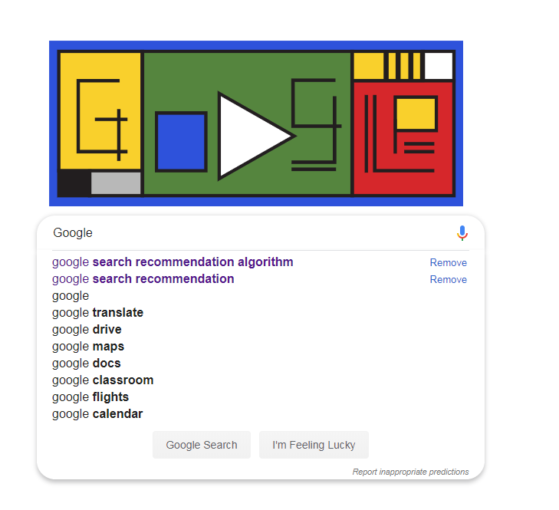
Google Search Recommendation

Slide 2















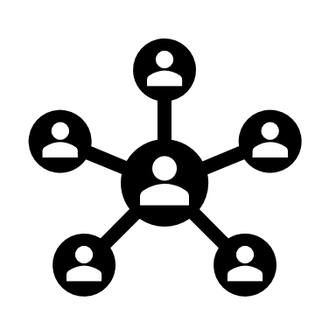














Google Search Recommendation
History
Search
Shopping
Social
Location
Health
Group
Movies
Sport…..
We give lots of info to google while we use any of the services offered by Google.
Google is learning the info and tailoring the info as per best of our interest or use.
There is hybrid approach behind this where google is able to respond to our query.

Slide 3
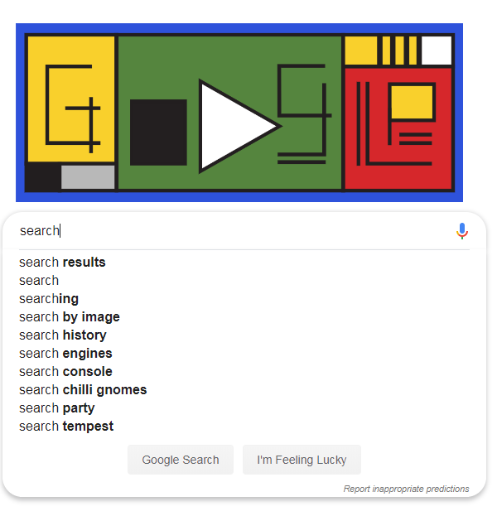
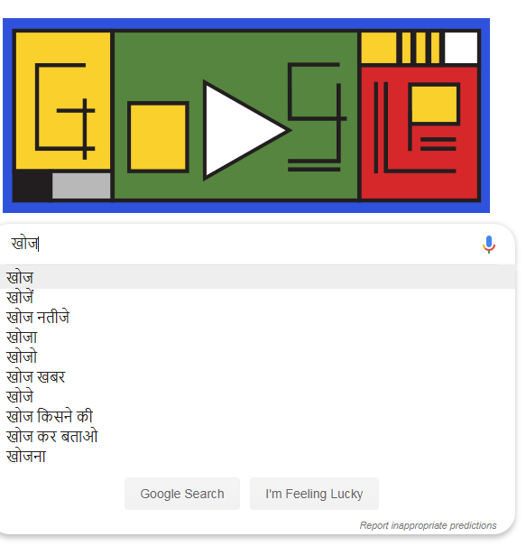
Search Predication by language
English
Hindi
Based on keyed text’s language Google is able to decide on the search predication language.

Slide 4
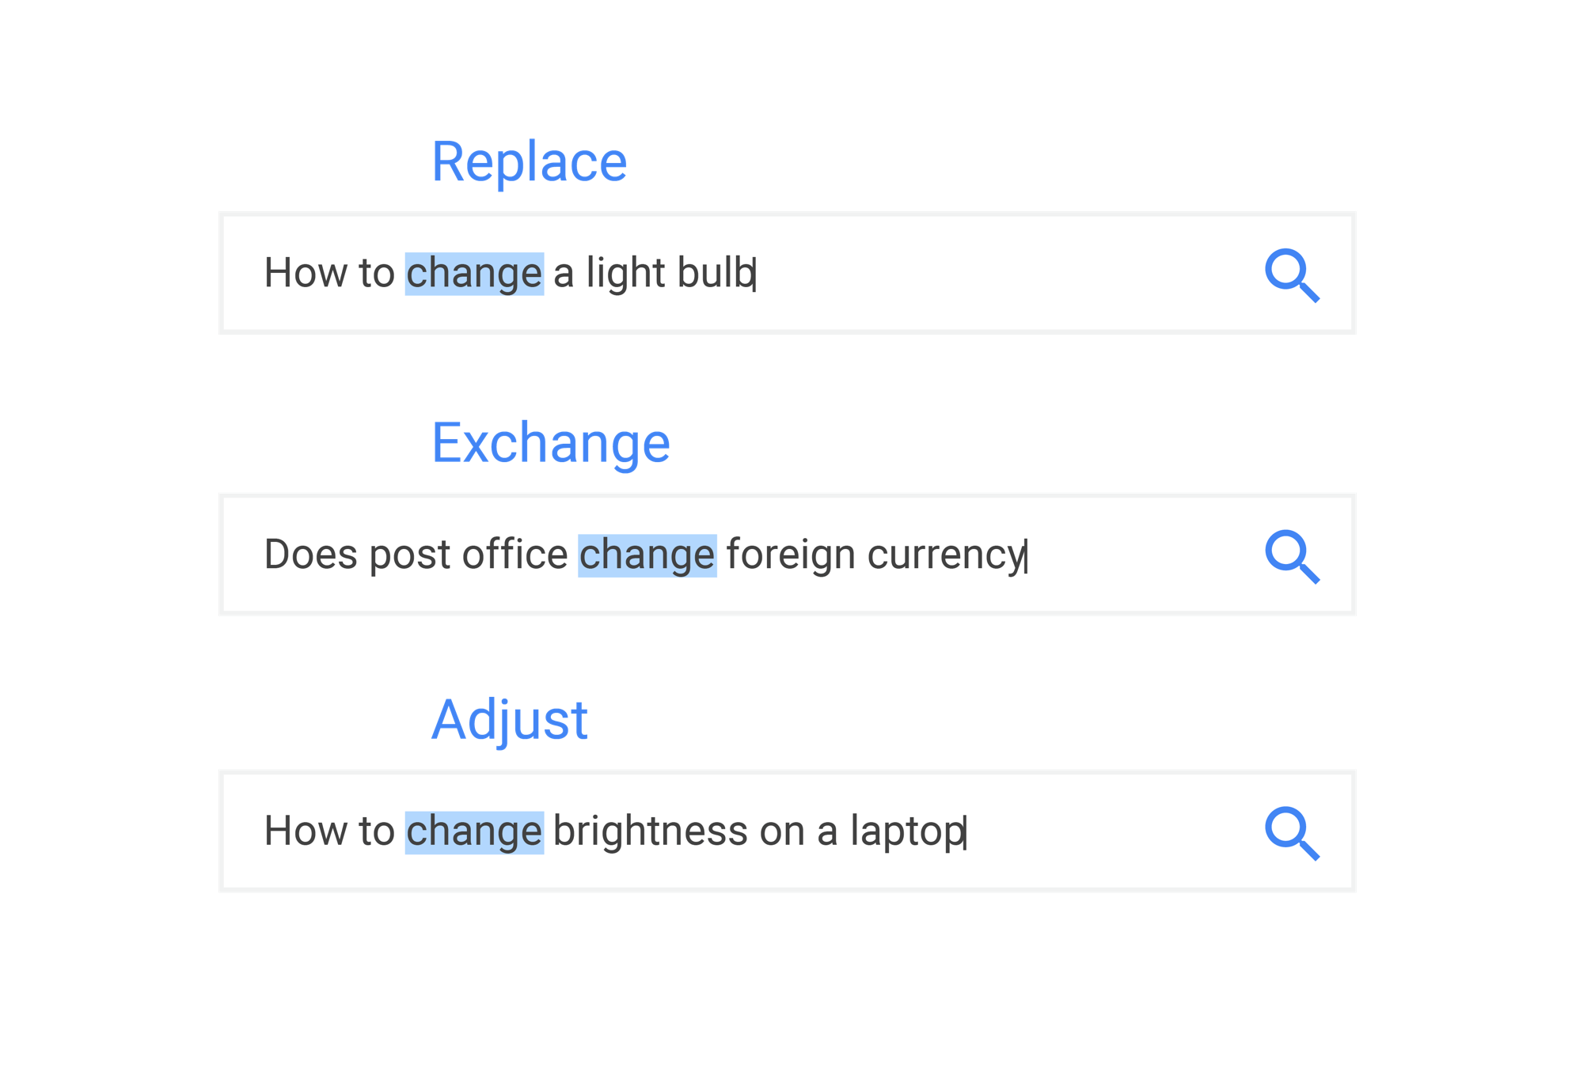
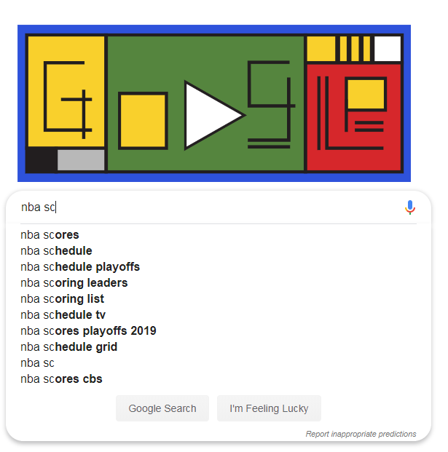
Giving you fresher, more recent search results
Search results, like warm cookies right out of the oven or cool refreshing fruit on a hot summer’s day, are best when they’re fresh. Even if you don’t specify it in your search, you probably want search results that are relevant and recent.
Based on keyed text’s language Google is able to decide on the search predication language.

Slide 5
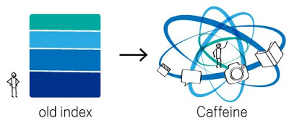
Giving you fresher, more recent search results
Old index < 2010
Several layers
Very few were refreshed at a faster rate than others
The main layer would update every couple of weeks.
To refresh a layer of the old index, Google would analyze the entire web, which meant there was a significant delay between when Content was created vs when google found it.
With Caffeine and Panda After 2010
Google has categorized data for search result :
Regularly recurring events:
Frequent updates:
Recent events or hot topics:
Caffeine lets Google index web pages on an enormous scale. In fact, every second Caffeine processes hundreds of thousands of pages in parallel. If this were a pile of paper it would grow three miles taller every second

Slide 6
Scenario Design
Who are your target customers?
Any user who is trying to find some info from the web.
This includes a big segment of the user base, organization, education, Government and many more.
What are their key goals?
User’s searching on Google should get the most relevant information.
It should be most accurate, as per the trend.
The user should be able to find the most relevant info without scrolling too much. That’s why we see lots of competition for ranking on 1st page of Google . for
Able to propose /predict possible search term in case of ambiguity in the first search
How can Google help its users accomplish those goals?
Google is using traditional / Machine Learning both content-based and Collaborative to predicts and recommends search terms

Slide 7
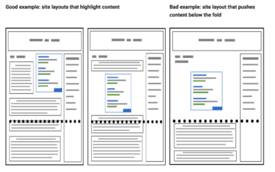
Scenario Design : Reverse Engineering
With the help of Machine Learning and help of PANDA rollout of google search engine google tries to read some key information from the website as part data collection .
Google Panda targets websites with the following problems:
Duplicate content
Low quality and thin pages that provide no real value to users
Websites with a bad user experience
External links to bad websites
Ad placement
Word Count & On Page Factors
Advertising & Affiliates
backlinks profile
How with other site
API calls
Load time
Sites with too many advertisements
Content from sites
Poor grammar and spelling
Too many broken links
Comments
http://www.bayardo.org/ps/vldb2009.pdf

Slide 8
Scenario Design : Search Term
Specific queries. E.g., “Does Netscape support the JDK 1.1 code-signing API?”
Broad-topic queries. E.g., “Find information about the Java programming language.”
Similar-page queries. E.g., “Find pages ‘similar’ to java.sun.com.”
Query <Wait >
Location
Event
Trends
People
…..
n
n
n
n
n
-Getting related terms from the cluster of data, based on users local Search history and Search based on Geolocation, Social Trends, current events, and many more.
-Giving some score to each terms based on the freshness of the data and then listing them users sections as user types .
- Google Search predication also resorve some section for some part of data. (next page)

Slide 9
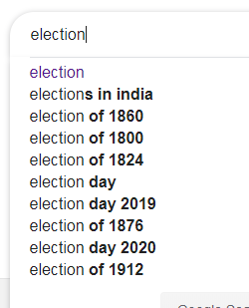
Search Terms Categorization
1
2
3
4
5
1
Data from searched History.
2
Data from Trending Events globally
5
Data from future events.
3
Data from Historical Event.
4
Data from Possible current years events

Slide 10
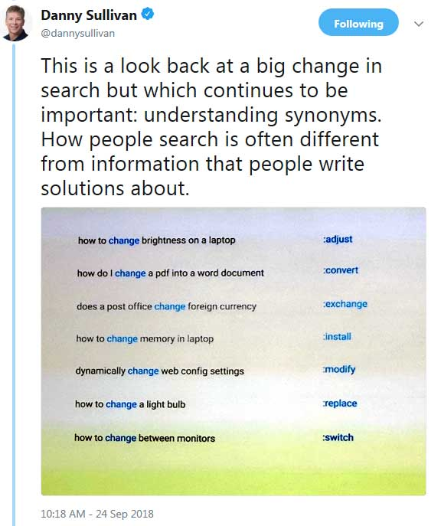
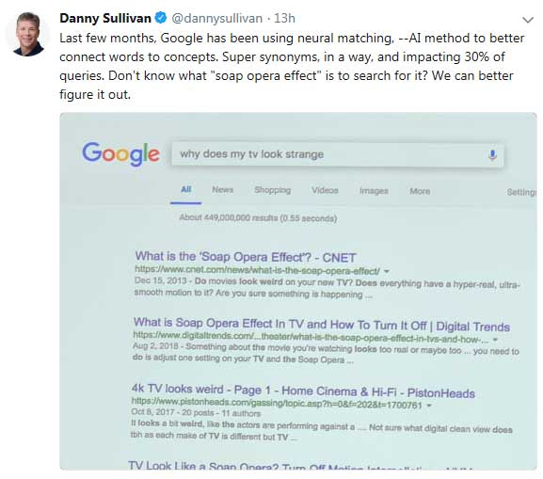
Using Terms

Slide 11
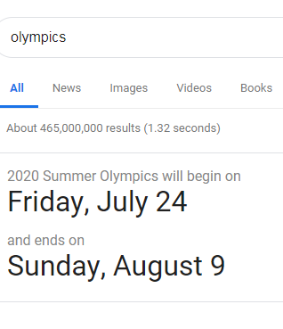
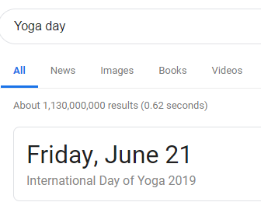
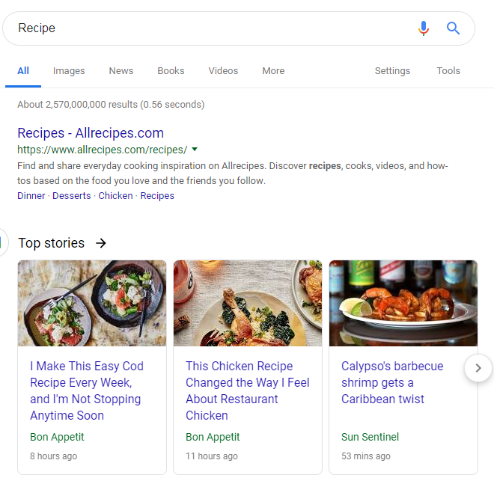
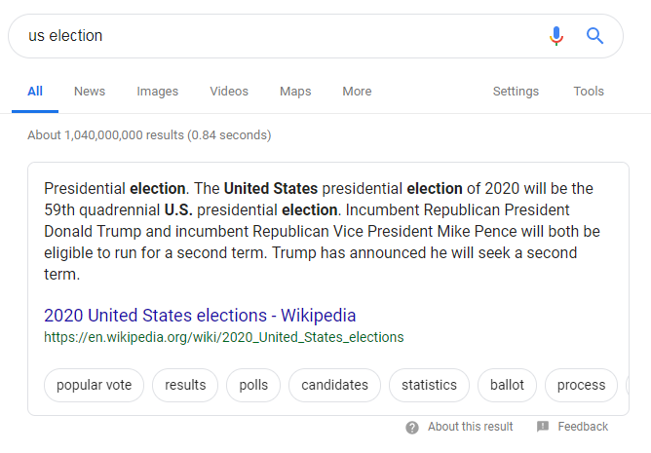
Possible Expectancy Matrix
Different searches have different freshness needs. This algorithmic improvement is designed to better understand how to differentiate between these kinds of searches and the level of freshness you need, and make sure you get the most up to the minute answers.
Some Example :
Search Term | Past Result | Future Result | Present Result
Score |  |  | Expected to See the Score of Game in the Resident country
Election |  | We are in 2019 , We may not be more interested in election of the Past, but more current or Future election.
Recipe | Valid to include such results , as it won’t change much. |  | Also any trending food’s recipe
Event |  | All possible future events of the country. | Expected to see all possible Event of the geo graphical location or country .
International Day/ Event / Sport |  | Showing the Future most current date of the event

Slide 12
Scenario Design : Search Result
Specific queries. E.g., “Does Netscape support the JDK 1.1 code-signing API?”
Broad-topic queries. E.g., “Find information about the Java programming language.”
Similar-page queries. E.g., “Find pages ‘similar’ to java.sun.com.”
Query
Increase Frequency by ONE for each page that is Present in each other. This would result in page with most referred among the top 200.
Matching Terms in While web very high
Authoritative
Definitive
This is very basic view, since high frequency doesn’t guarantee that you will have great content.
Top 200 page

Slide 13
Appendix
https://arxiv.org/pdf/1711.08611.pdf
https://www.cs.cornell.edu/home/kleinber/auth.pdf
http://www.bayardo.org/ps/vldb2009.pdf https://blog.monitorbacklinks.com/seo/recover-google-panda-penalty/ https://www.forbes.com/sites/lutzfinger/2014/09/02/recommendation-engines-the-reason-why-we-love-big-data/#589fafba1077
https://www.google.com/search/howsearchworks/algorithms/
https://search.googleblog.com/2011/11/giving-you-fresher-more-recent-search.html
https://googleblog.blogspot.com/2011/11/giving-you-fresher-more-recent-search.html
https://googleblog.blogspot.com/2010/06/our-new-search-index-caffeine.html
https://vannizhang.github.io/wonder/#
https://www.youtube.com/embed/IdjJgd6gezM

Slide 14
https://www.theguardian.com/technology/2019/feb/06/whatsapp-deleting-two-million-accounts-per-month-to-stop-fake-news

Slide 15

G
G
G
G

